Slide 1
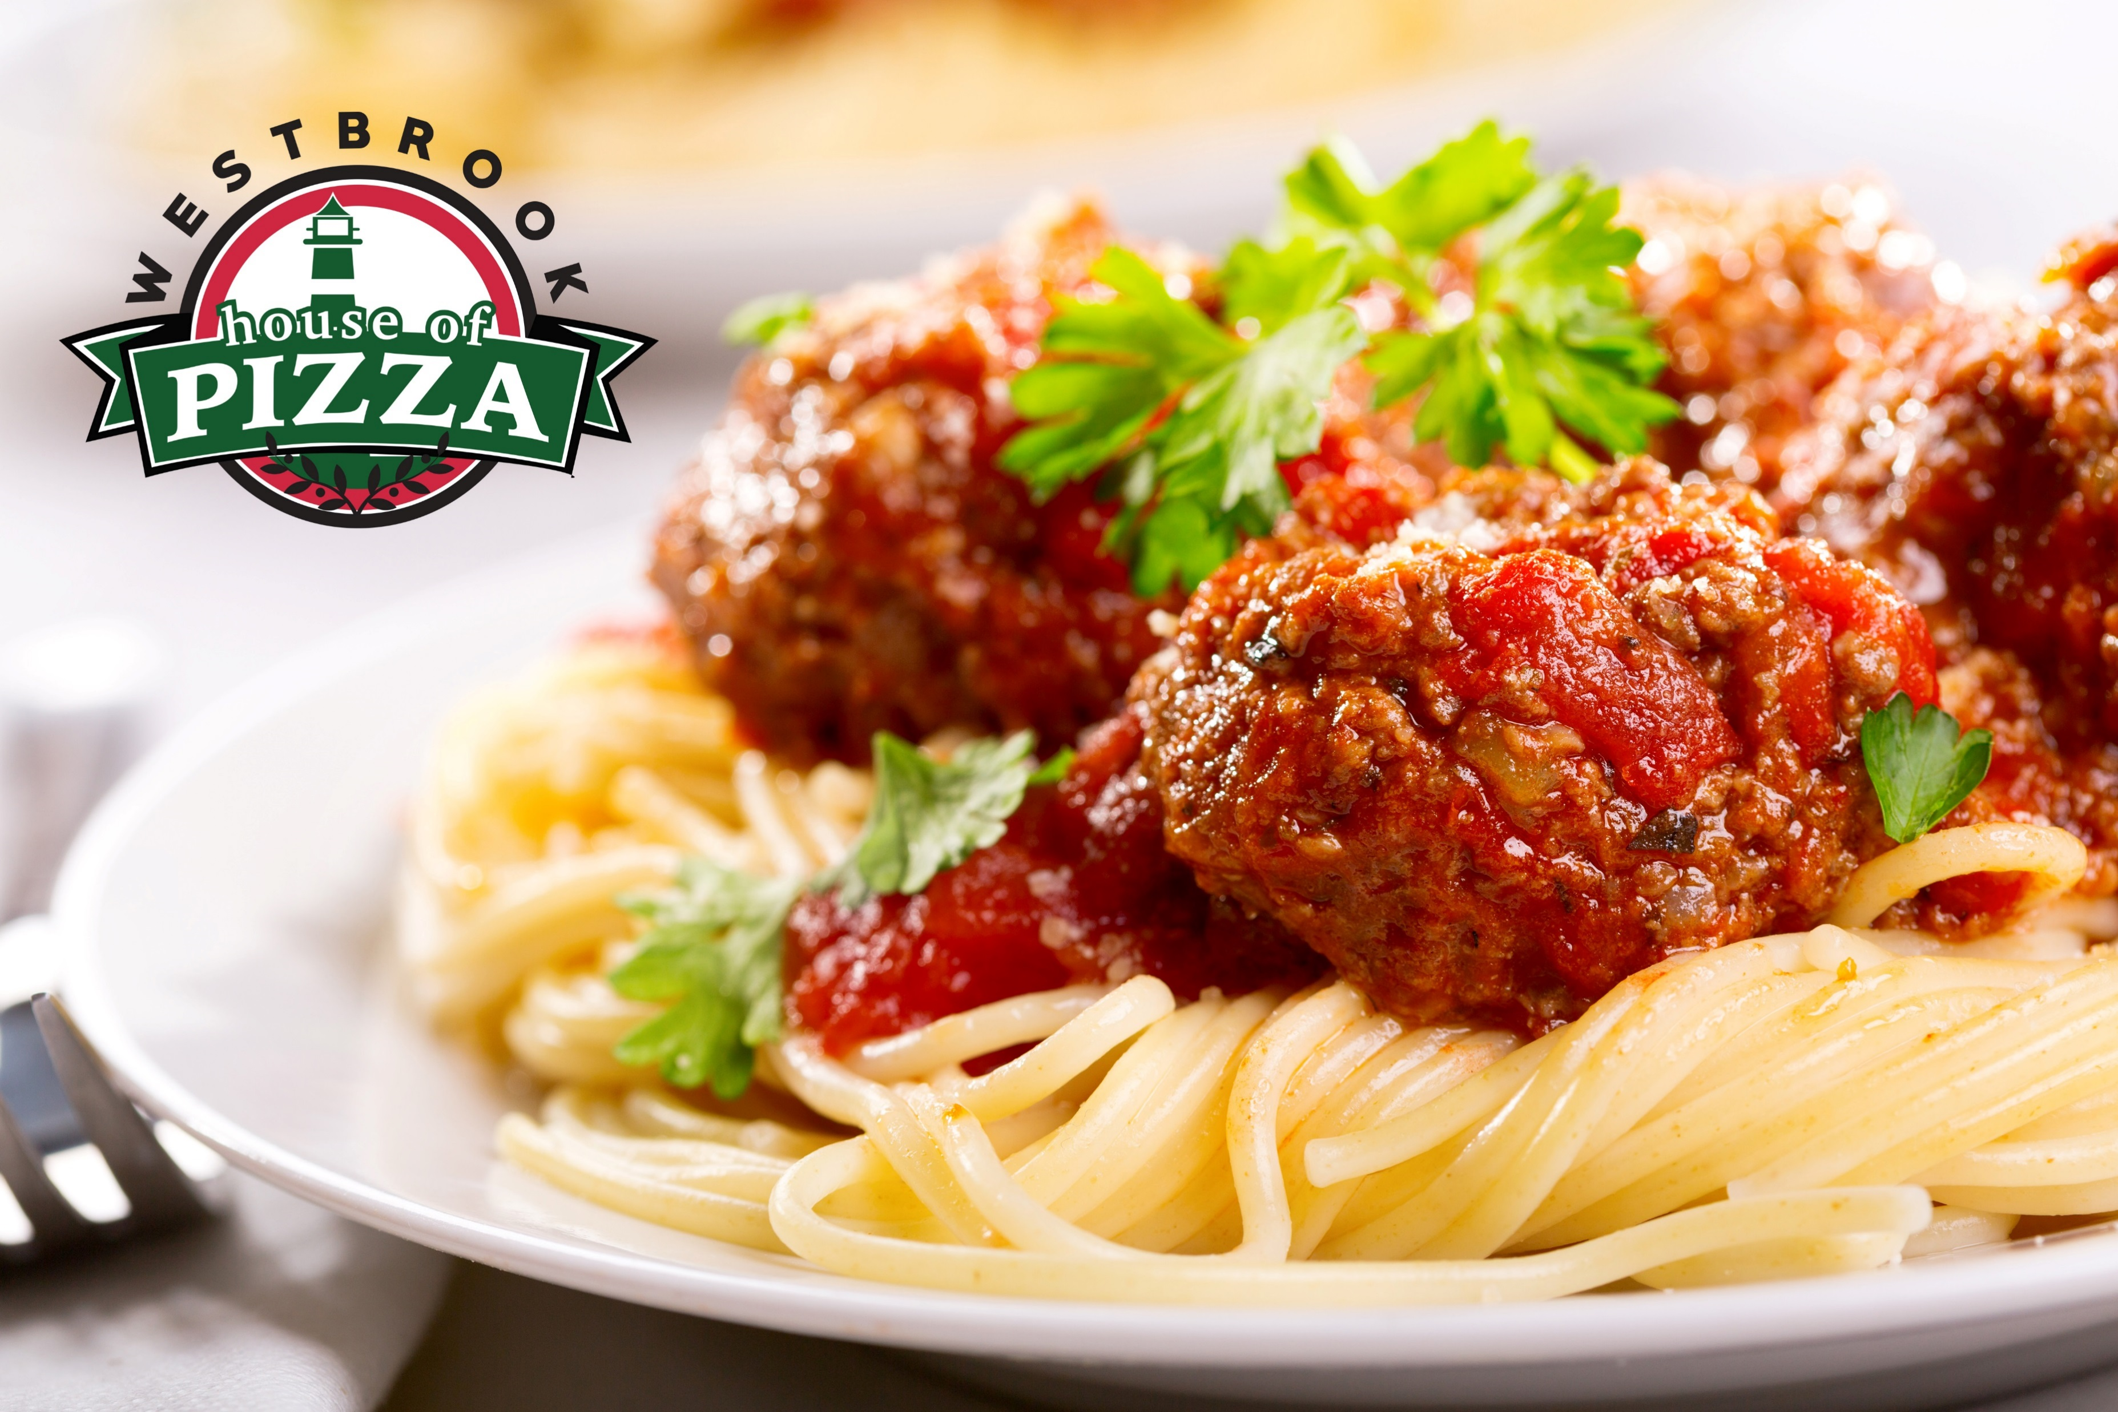
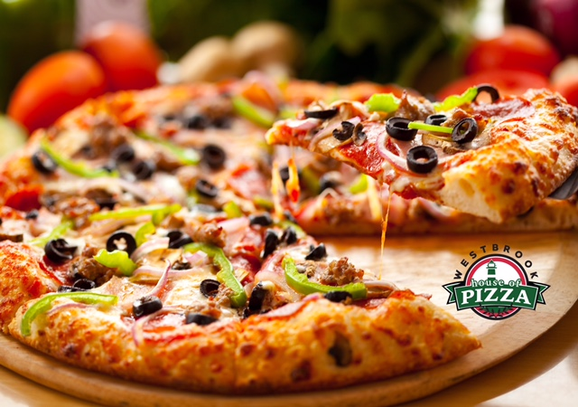
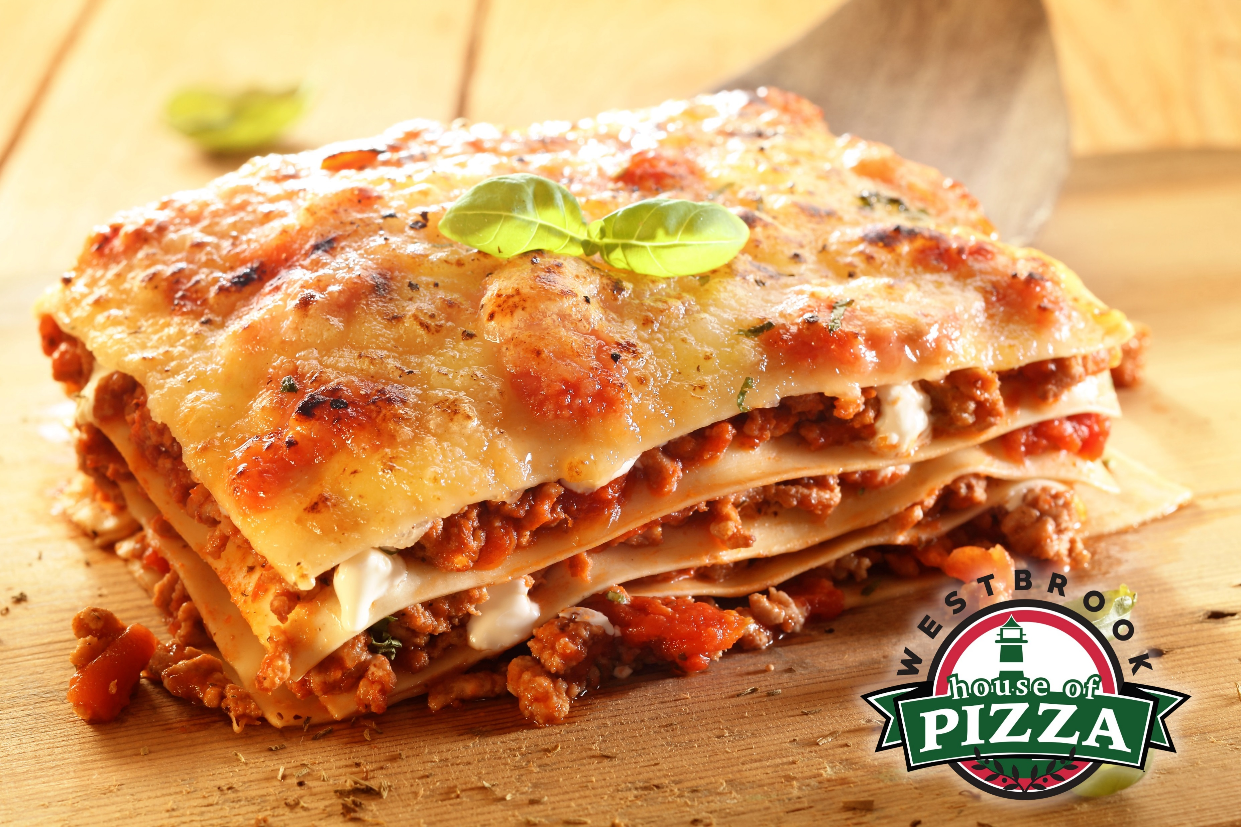
PIZZA
10” 16”
Plain Cheese 10.95 18.95
One-Way 11.95 19.95
Two-Way 12.95 20.95
Three-Way 13.95 21.95
Four-Way 14.95 22.95
Extra Cheese 2.75 3.75
Gluten Free and Calzone options Available
Available Toppings
Pepperoni Onion Sausage Pepper Ham
Mushroom Hamburg Broccoli Salami Meatballs
Black Olives Pineapple Jalapeños Tomato Bacon
Feta Cheese Spinach Chicken Anchovies Ricotta
Shaved Steak Alfredo BBQ Sauce Blue Cheese Pesto
*Blue indicate Premium Topping*
GOURMET PIZZA
10” 16”
Chicken Alfredo Pizza 14.95 24.95
Meat Lovers Pizza 14.95 24.95
Greek Pizza 14.95 24.95
BBQ Chicken Pizza 14.95 24.95
Buffalo Chicken Pizza 14.95 24.95
Veggie Pizza 14.95 24.95
Shrimp Scampi Pizza 14.95 24.95
Chicken Pesto Pizza 14.95 24.95
Taco Pizza 14.95 24.95
Loaded Pizza 14.95 24.95
Big Mack Pizza 14.45 24.95
Loaded Steak Pizza 14.95 24.95
LASAGNA – RAVIOLI - MANICOTTI
Served with garlic bread
Marinara Sauce 12.95
Mushrooms 13.95
Meatballs 13.95
Sausage 13.95
Loaded 14.95
Side Salad 4.75
ZITI ALFREDO
With Chicken 12.50
With Shrimp 12.50
SPAGHETTI OR ZITI
Served with garlic bread
Marinara Sauce 10.95 Sausage 11.95
Meatball 11.95 Mushrooms 11.95 Chicken 11.95 Eggplant 11.95
Loaded 12.95
Side Salad 4.25
Baked with cheese add $2.55

Slide 2
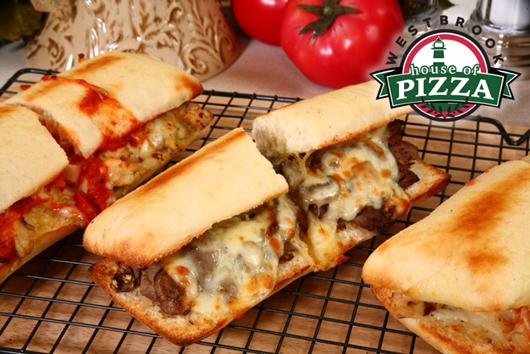
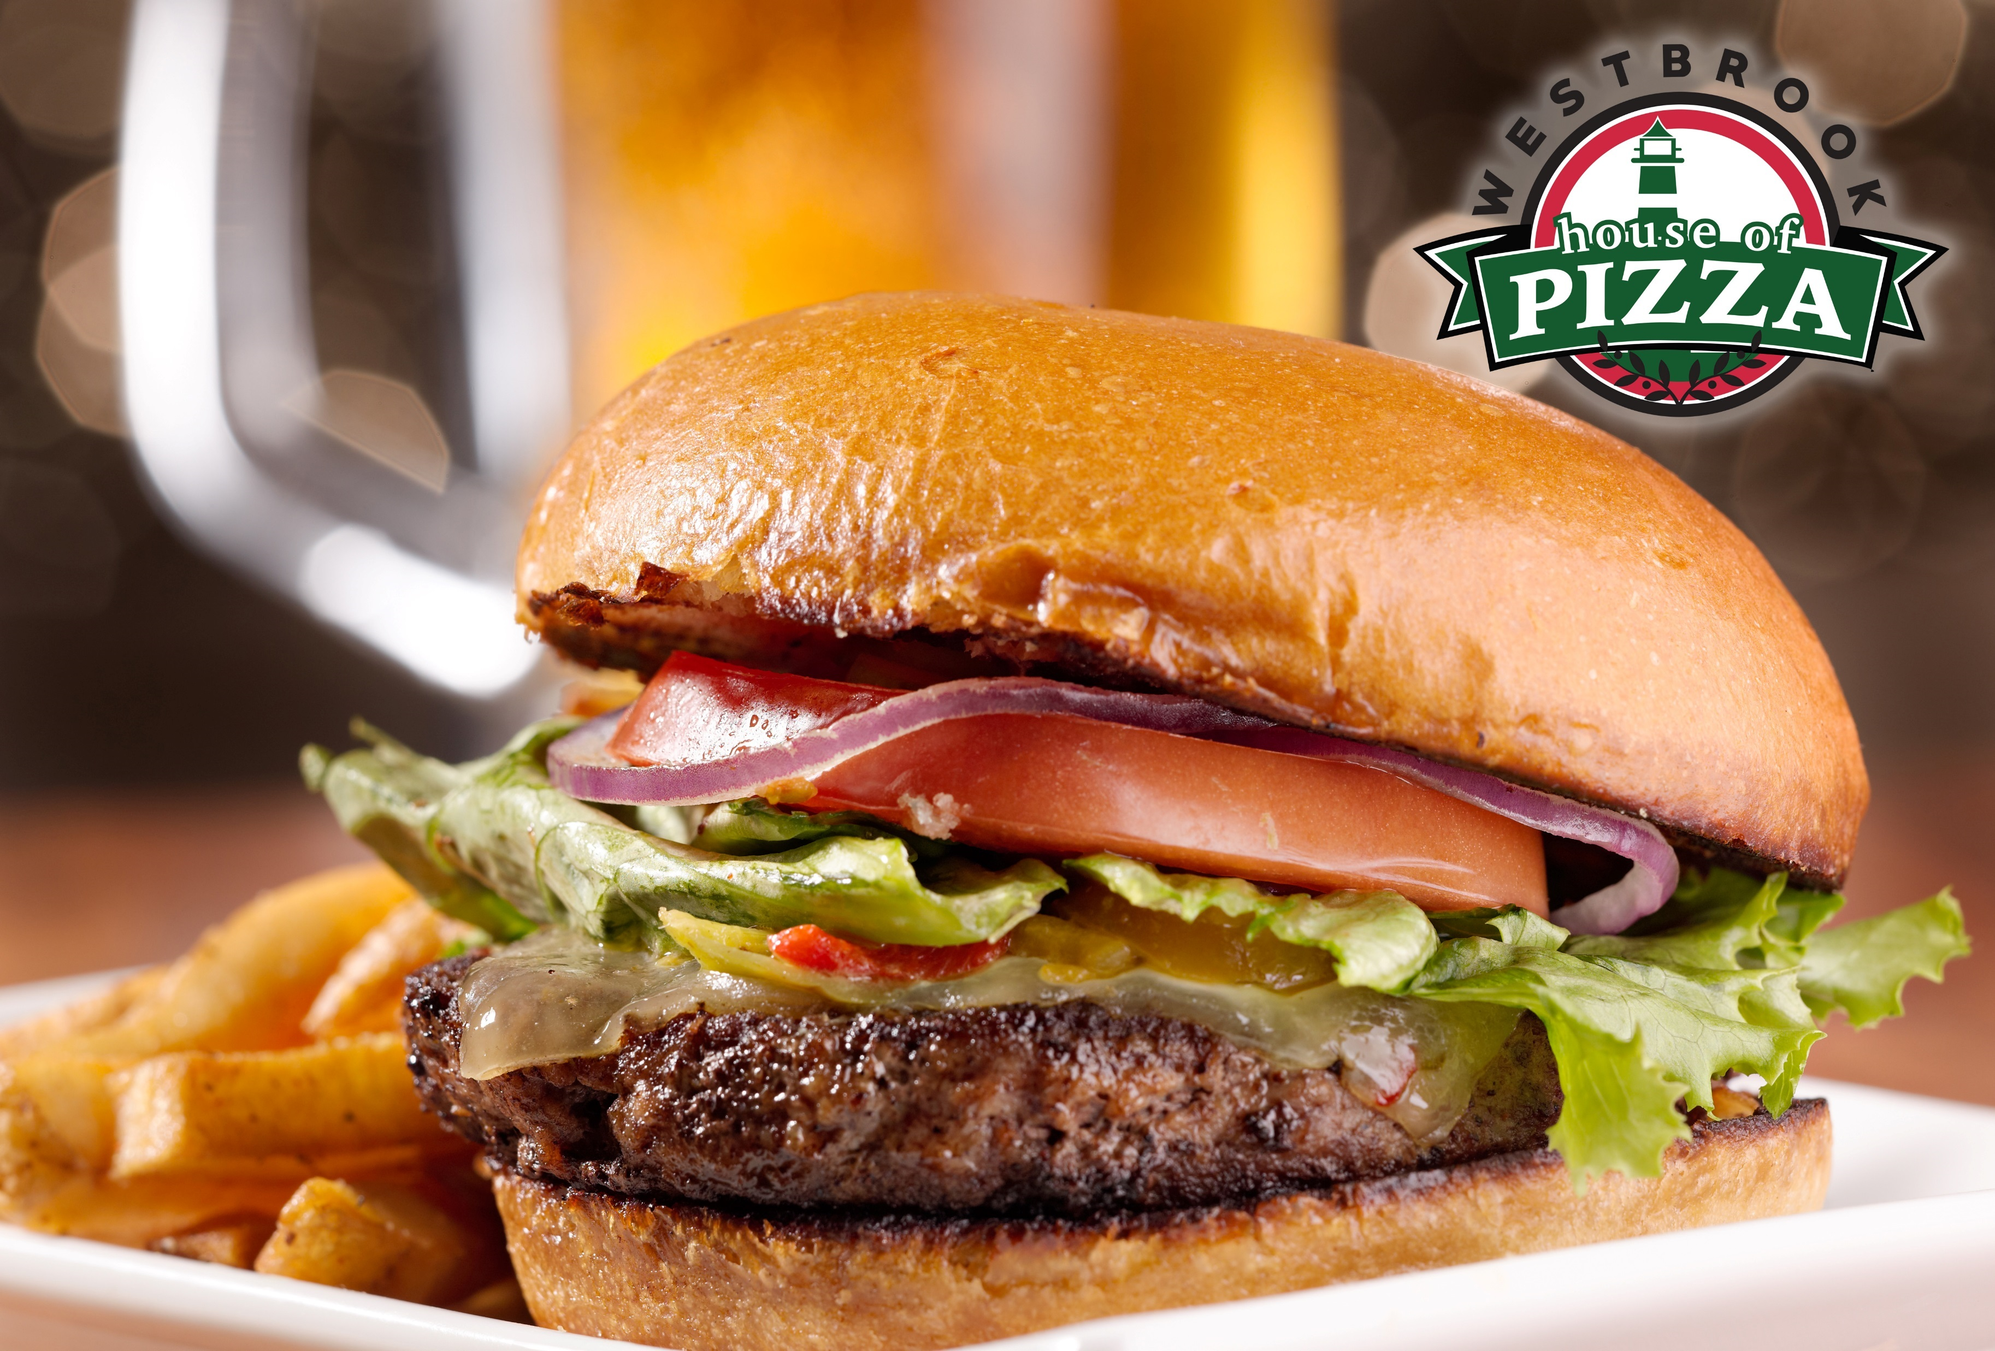
DINNERS
(Served with salad and french fries)
Cheeseburger Plate 14.75
Clam Cake Plate 14.75
Steak Tip Plate 14.75
Buffalo Wing Plate 14.75
Chicken Fingers Plate 14.75
Chicken Kabobs Plate 14.75
Chicken Sandwich Plate 14.75
Fish & Chips Plate 14.75
PARMESAN GRINDERS
Meatball 10.95 12.75
Sausage 10.95 12.75
Eggplant 10.95 12.75
Chicken 10.95 12.75
QUESADILLAS
Veggie 12.75 Chicken or Steak 13.95
FROM THE GRILL AND CHARBROIL
Steak & Cheese 10.75 12.55
Onion Steak 10.95 12.75
Pepper Steak 10.95 12.75
Mushroom Steak 10.95 12.75
Loaded Steak 11.55 12.95
Steak Bomb 11.75 13.55
Hamburger 6.95
Cheeseburger 7.95
Cheeseburger Sub 11.55 12.95
Pastrami 11.55 12.95
Chicken Kabob 11.55 12.95
Steak Tip Sub 11.95 13.75
Gyro 10.95
Chicken Gyro 10.95
Add French Fries - $5.25
GRINDERS (Hot Sandwiches) or WRAPS
Roast Beef 10.95 12.75
Turkey 10.95 12.75
Italian 11.35 12.95
Ham 10.95 12.75
Salami 10.95 12.75
Genoa Salami 11.35 12.95
Vegetarian 10.75 12.55
Tuna Fish 10.75 12.55
BLT 10.95 12.75
Special Sub 11.75 13.55
Poor Boy 10.55 11.95
Rich Boy 10.75 12.55
Fish Sandwich 8.95
Chicken Sandwich 8.95
SPECIALTY WRAPS
Buffalo Chicken 12.95 Chicken Caesar 12.95
BBQ Chicken 12.95 Pesto Chicken 12.95
Mediterranean Wrap 12.95
LET US CATER YOUR EVENTS!

Slide 3
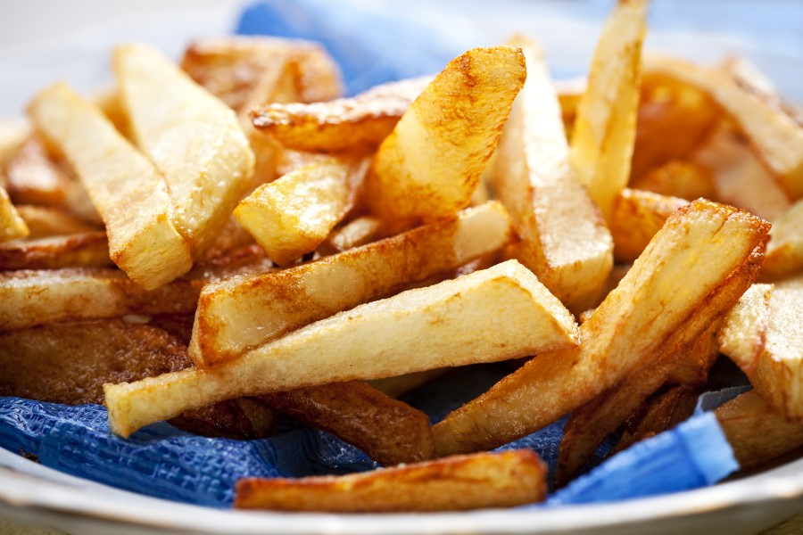
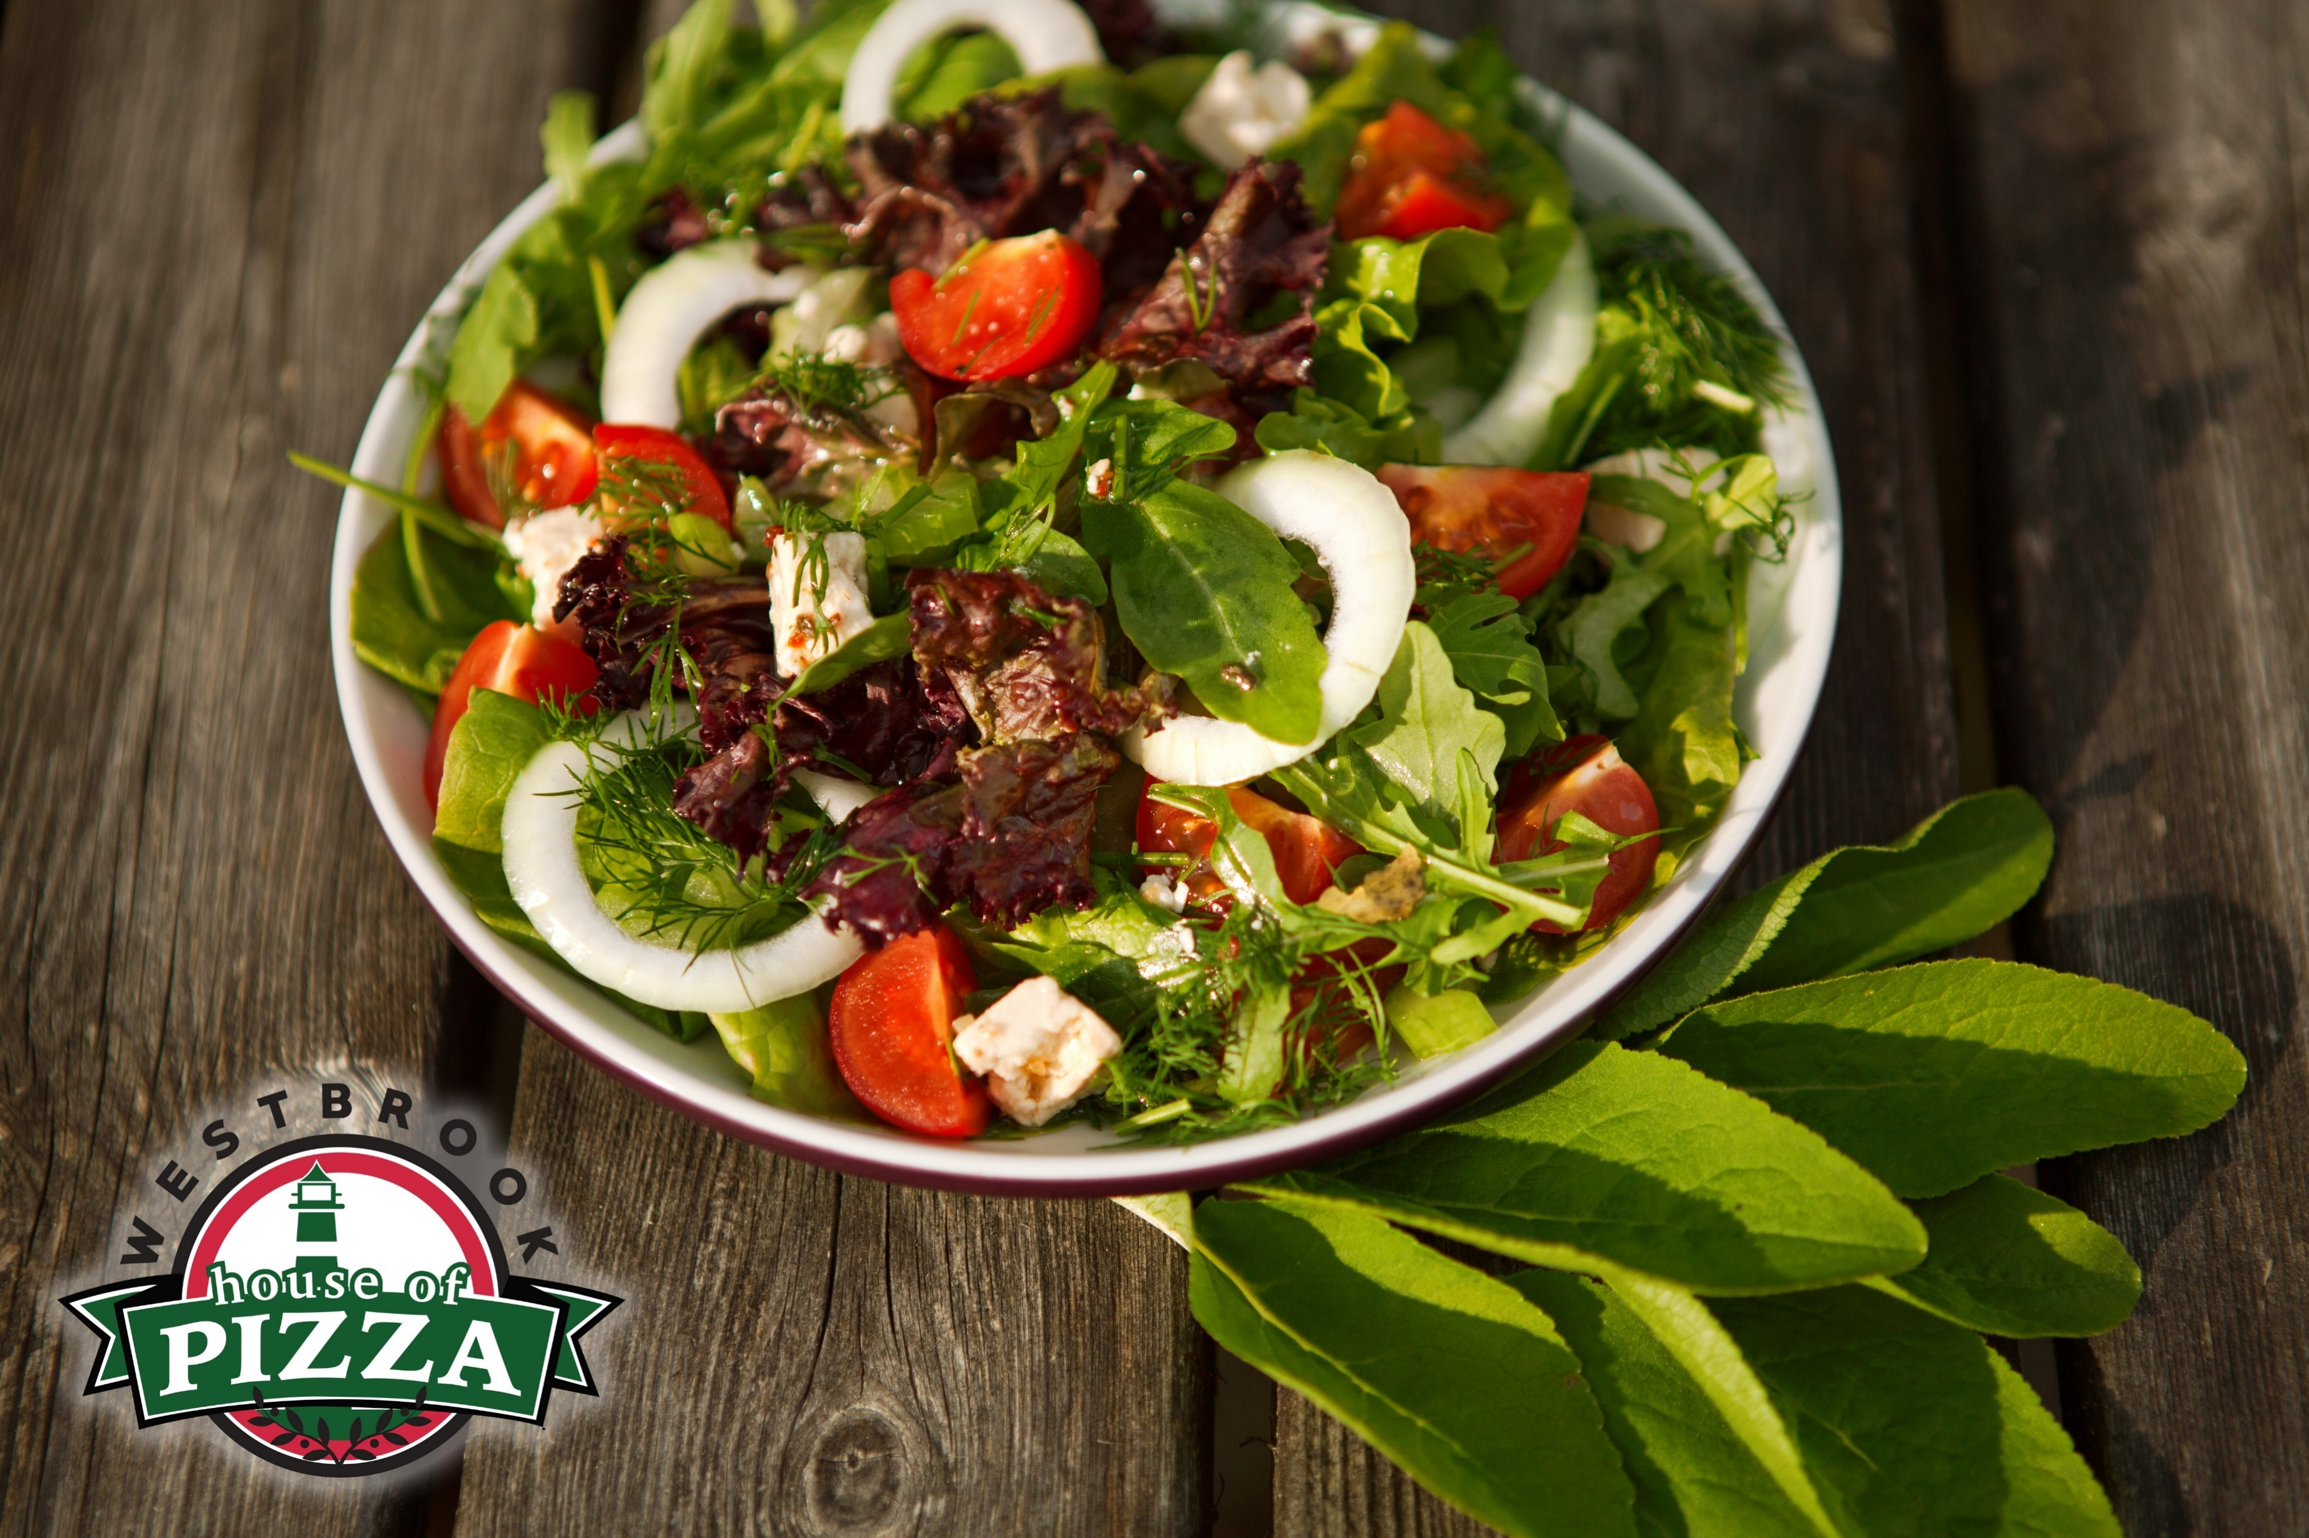
SALADS or MAKE IT A WRAP
Tossed Salad 10.75
Tuna Salad 11.95
Chef’s Salad 11.95
Antipasto Salad 11.95
Greek Salad 11.95
with Chicken 13.95
with Steak 14.95
Grilled Chicken Salad 12.95
Buffalo Chicken Salad 12.95
Steak Tips Salad 13.25
SIDE ORDERS
French Fries 5.25
Onion Rings 5.95
Chicken Fingers 11.95
Buffalo Wings 12.95
Mozzarella Sticks 9.95
Jalapeno Poppers 9.95
Buffalo Tenders 12.55
Bread Sticks 10.95
Garlic Bread 3.35
with cheese 3.95
Combo 12.95
Veggie Nachos 12.55
Beef Nachos 13.75
Chicken Nachos 13.75
DESSERTS
Brownies 4.75
Baklava 4.75
BEVERAGES
Fountain Soda 2.55
Bottled Drinks 2.95
Energy Drinks 3.95
Chocolate Milk 2.95
Juice 2.95
BEER & WINE
Bottled
Domestic Beers & Hard Ciders 3.95
Imported 4.25
Draft Beers
Budweiser/Bud Light 4.25
Local Breweries 7.95
Wines 8.00

